Slide 1
Travel Route Planner using GA and solving TSP
Group 12
2019145081 Taejun Kang
2020147049 Hyundong Kim

Slide 2

Contents
Contribution of the Source Paper
Contribution of the Mid-Term PT
Limitation of the Mid-Term PT
Extension
Data
Result Comparison
Conclusion
Limitations and Future Work
Reference
Appendix(Code)

Slide 3
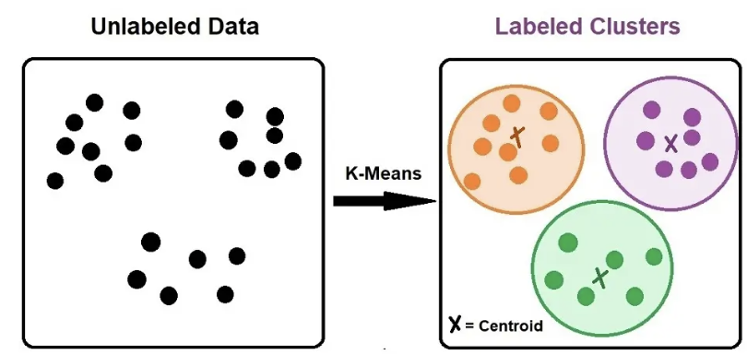
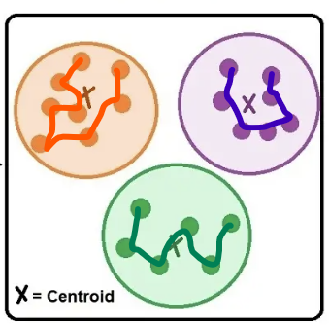
Contribution of the Source Paper
A Development of Travel Itinerary Planning Application using Traveling Salesman Problem and K-Means Clustering Approach. - Rani, S., Kholidah, K. N., & Huda, S. N.
Algorithm for making travel itinerary using TSP and k-means clustering technique is proposed.
Travel Routes
TSP
https://www.ejable.com/tech-corner/ai-machine-learning-and-deep-learning/k-means-clustering/

Slide 4
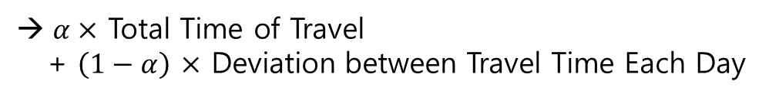
Contribution of the Mid-Term PT
Clusters are formed based only on the points’ distance.
Without considering the size of clusters
Some cluster may contain too many points for daily travel.
To overcome the limitation of the original paper,
We changed the clustering method from K-means clustering to GA
Fitness Function of GA
Day 1
$α×$ Total Time of Travel
+ $\left(1−α\right)$ $×$ Deviation between Travel Time Each Day
Day 2

Slide 5
Limitation of the Mid-Term PT
We didn’t consider the stay time at the tourist attraction and only considered travel time, which is far from tour planning in reality.
?
?
?
?
https://www.ejable.com/tech-corner/ai-machine-learning-and-deep-learning/k-means-clustering/

Slide 6
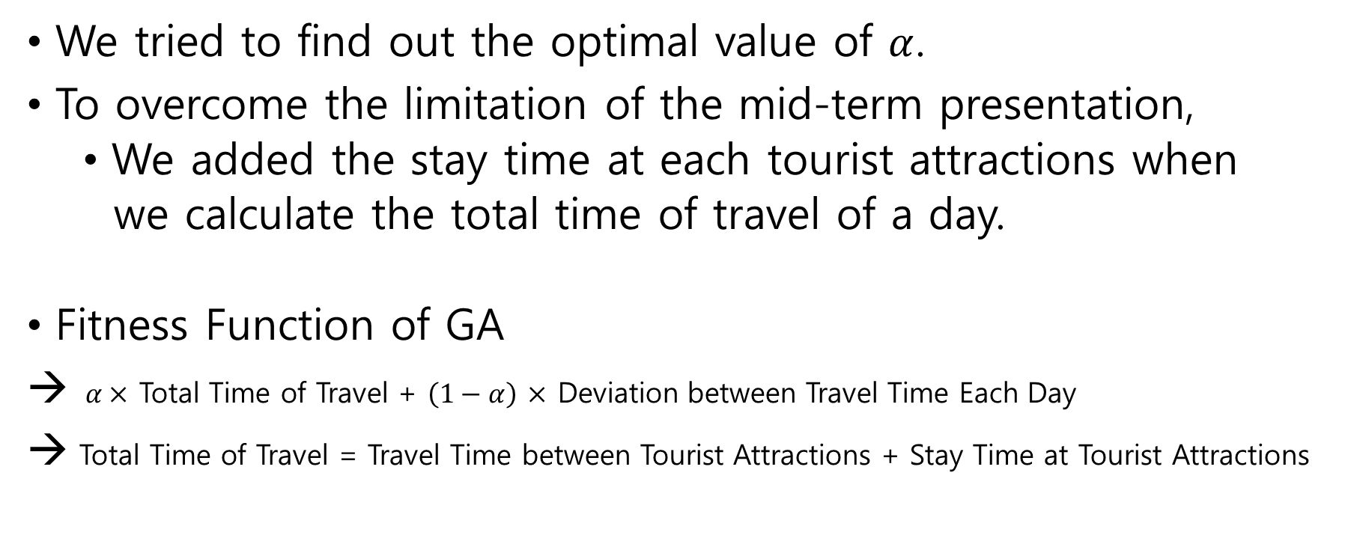
Extension
We tried to find out the optimal value of $α$.
To overcome the limitation of the mid-term presentation,
We added the stay time at each tourist attractions when
we calculate the total time of travel of a day.
Fitness Function of GA
→ $α×$ Total Time of Travel + $\left(1−α\right)$ $×$ Deviation between Travel Time Each Day
→ Total Time of Travel = Travel Time between Tourist Attractions + Stay Time at Tourist Attractions

Slide 7
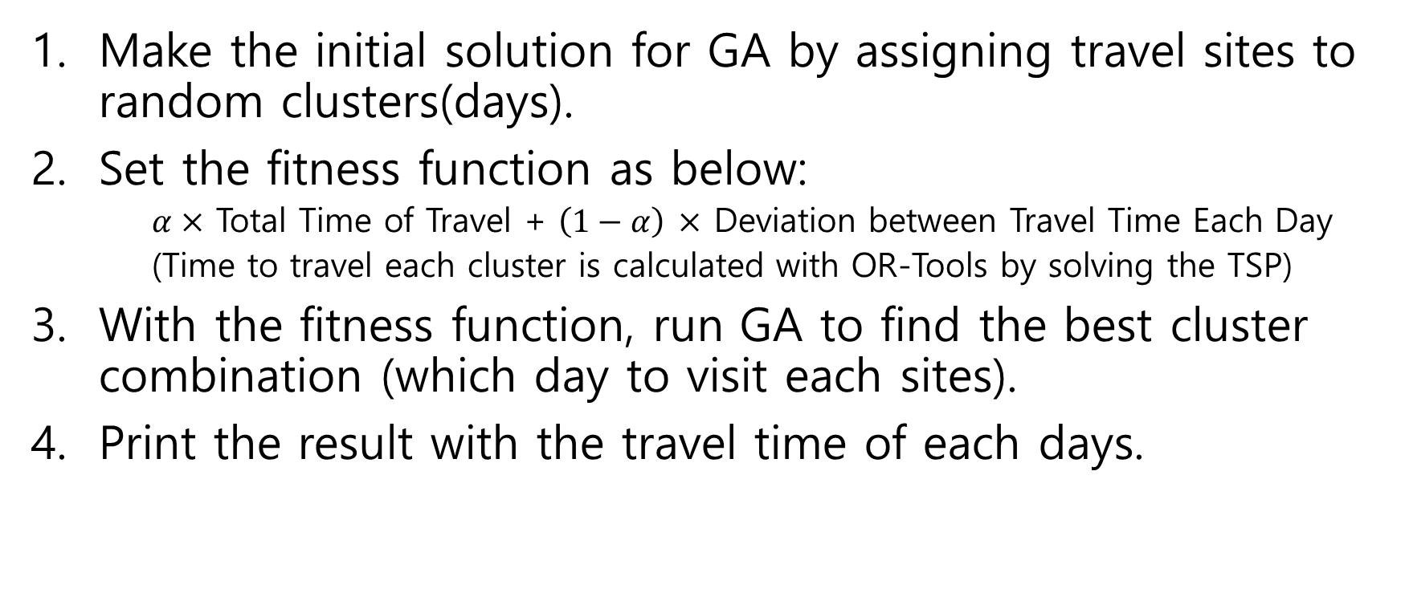
Methodology
Make the initial solution for GA by assigning travel sites to random clusters(days).
Set the fitness function as below:
$α×$ Total Time of Travel + $\left(1−α\right)$ $×$ Deviation between Travel Time Each Day
(Time to travel each cluster is calculated with OR-Tools by solving the TSP)
With the fitness function, run GA to find the best cluster combination (which day to visit each sites).
Print the result with the travel time of each days.

Slide 8
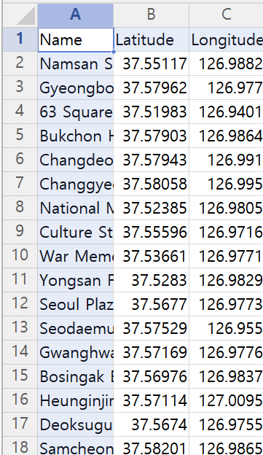
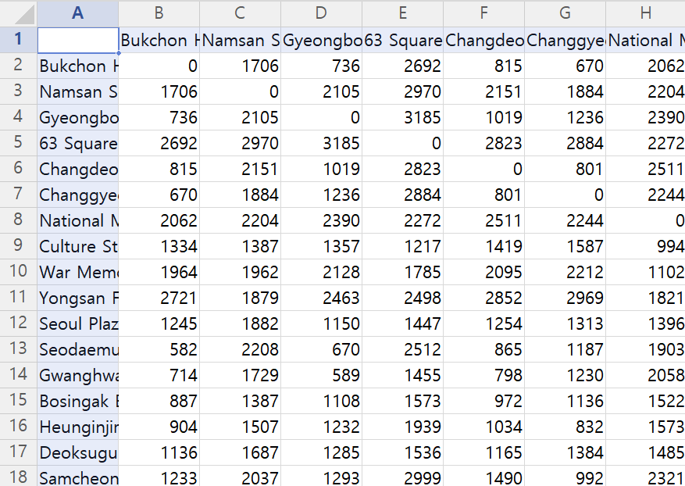
Data
Longitude and Latitude of 34 Tourist Attractions (via Google Map)
Time Duration by Public Transportation between 34 Tourist Attractions (via Google Map)
List of Attractions
'Bukchon Hanok Village', 'Namsan Seoul Tower', 'Gyeongbokgung Palace', '63 Square', 'Changdeokgung Palace', 'Changgyeonggung Palace', 'National Museum of Korea', 'Culture Station Seoul 284', 'War Memorial of Korea', 'Yongsan Family Park', 'Seoul Plaza', 'Seodaemun Prison History Museum', 'Gwanghwamun Square', 'Bosingak Belfry', 'Heunginjimun Gate', 'Deoksugung Palace', 'Samcheong-dong Alley', 'Bangi-dong Baekje Tombs', 'Myeongdong Cathedral', 'Hwangudan Altar', 'The Blue House', 'National Assembly Building', 'National Library of Korea', 'Bukak Skyway Octagonal Pavilion', 'Banpo Bridge Night View', 'Lotte World Tower', 'Sungnyemun Gate', 'Seoullo 7017', 'Deoksugung Stonewall Walkway', 'Dongdaemun Design Plaza (DDP)', 'Starfield Library', 'Namdaemun Market Tourist Information Center', 'Ikseon-dong Hanok Street'

Slide 9
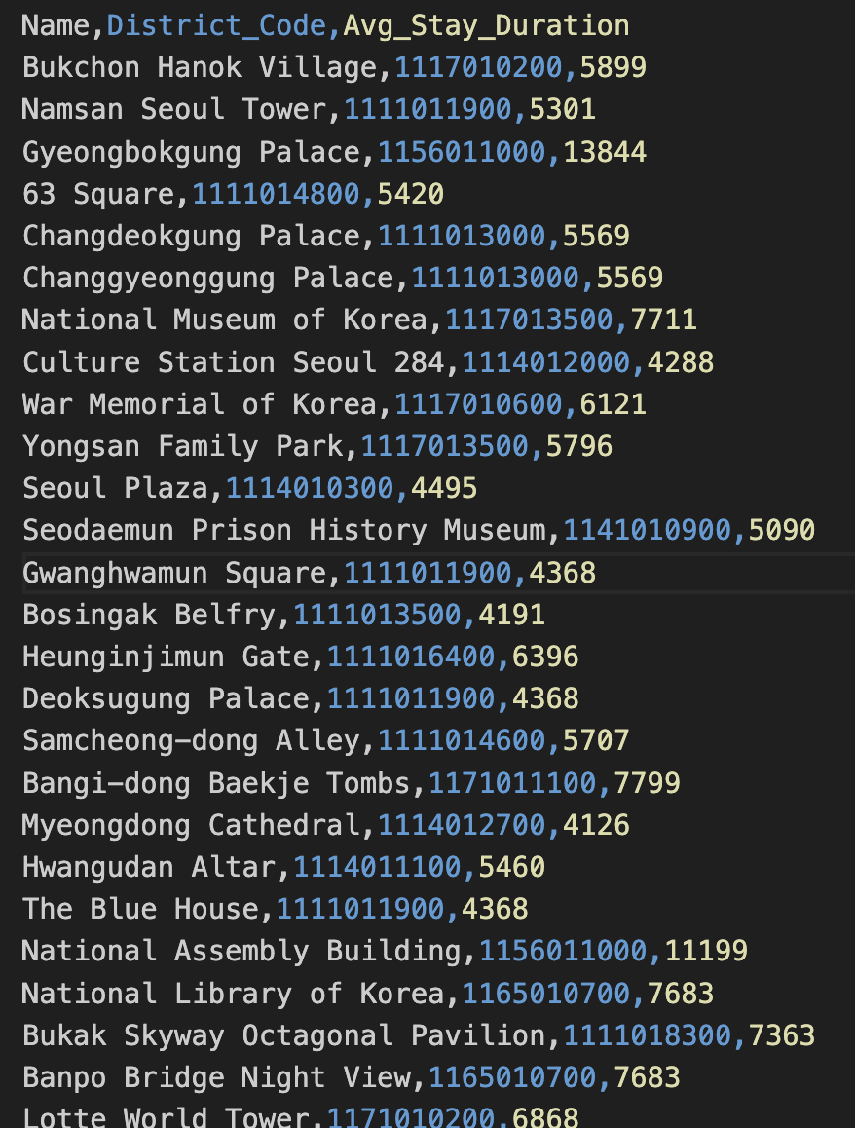
Newly Added Data
SK Open API Geovision Puzzle Data
Stay time at every tourist attractions
Administrative Standard Code Management System
Statutory Neighborhood Code

Slide 10
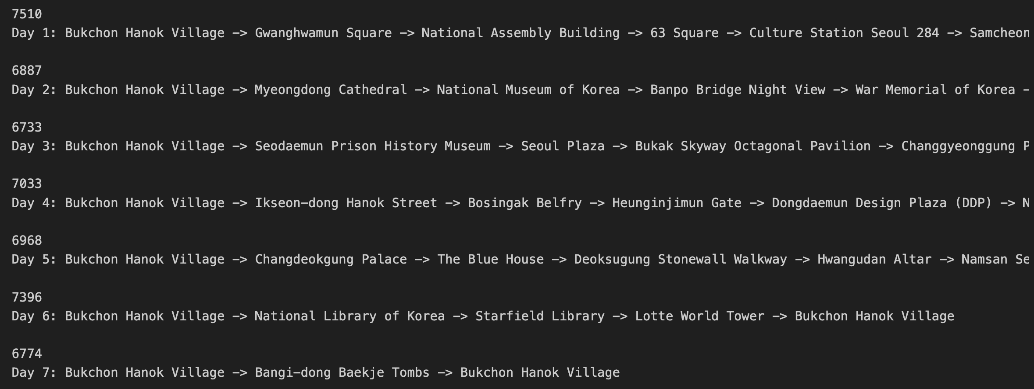
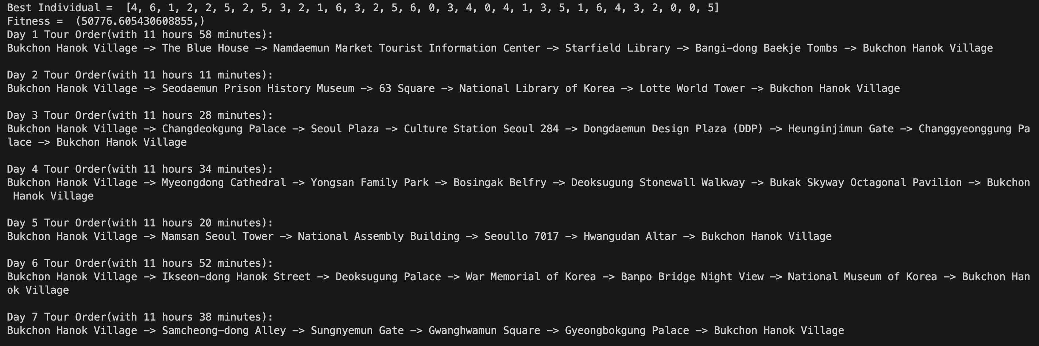
Result Comparison with Mid-Term PT
Mid-Term PT (solved without stay time)
Suggestion (with stay time)
Low fluctuation between days.
Min. 1hour 52min
Max. 2hour 5min for travel time
→ Enough time for sight-seeing (Estimation)
Low fluctuation between days.
Min. 11hour 11min
Max. 11hour 58min for travel time and sightseeing
We can find out that there actually is enough time for both travelling between attractions and sightseeing

Slide 11
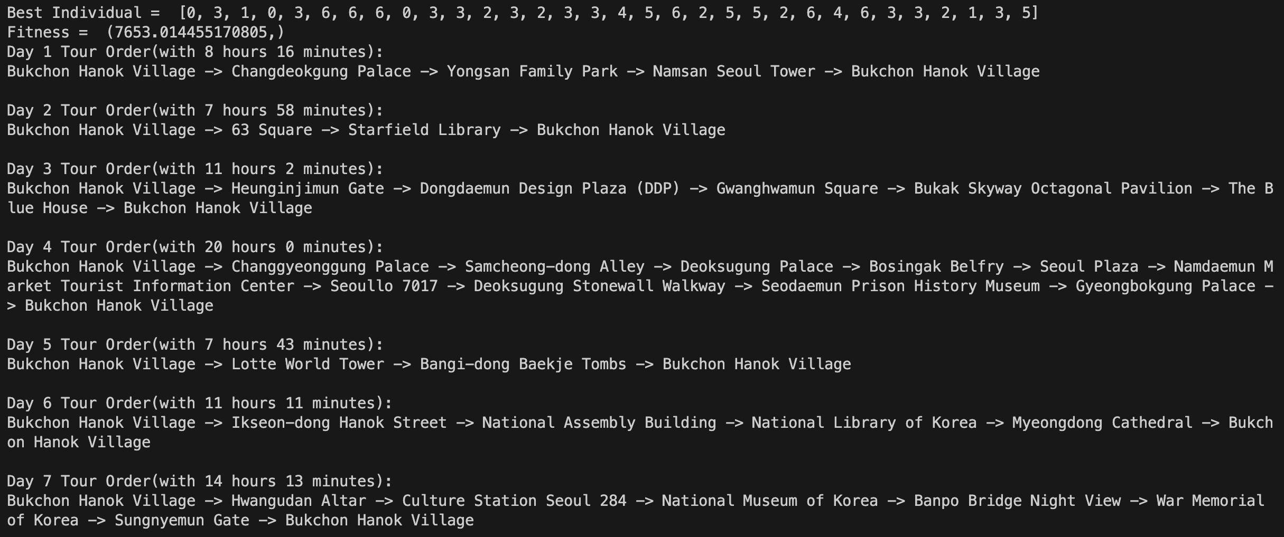
Result Comparison with Mid-Term PT
Mid-Term PT (after adding stay time)
Suggestion (with stay time)
Increased fluctuation between days.
Min. 7hour 43min
Max. 20hour for travel time and sightseeing
→ 20 hours for travel time and sightseeing for a day might be inappropriate.
Low fluctuation between days.
Min. 11hour 11min
Max. 11hour 58min for travel time and sightseeing
We can find out that there actually is enough time for both travelling between attractions and sightseeing

Slide 12
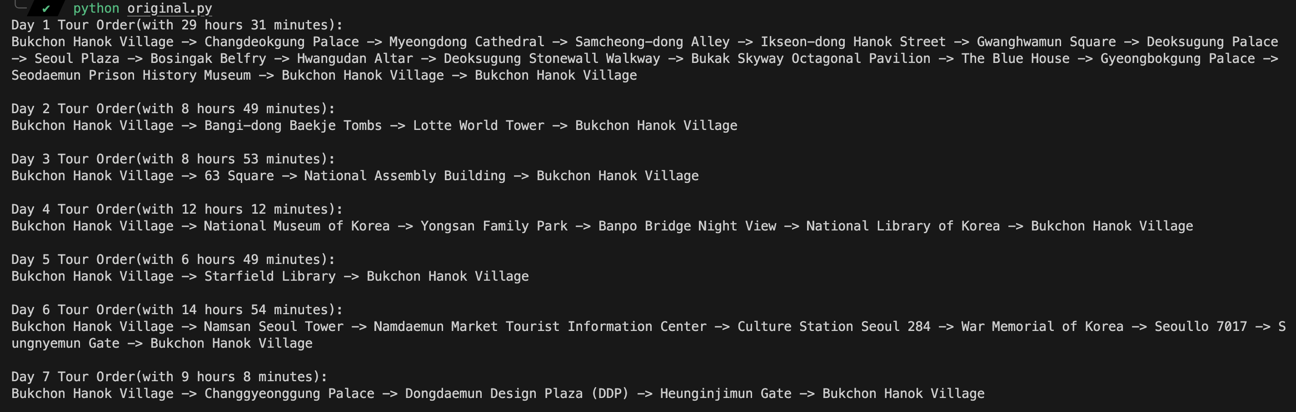
Result Comparison with Paper
Paper (K-means Clustering)
Suggestion (GA)
High fluctuation between days and infeasible solution.
Min. 6hour 49min
Max. 29hour 31min for travel time and sightseeing
→ In case of maximum time, it exceeds 24hours which means it is not appropriate for one-day plan.
Low fluctuation between days and feasible solutions.
Min. 11hour 11min
Max. 11hour 58min for travel time and sightseeing
We can find out that there is enough time for both travelling between attractions and sightseeing

Slide 13
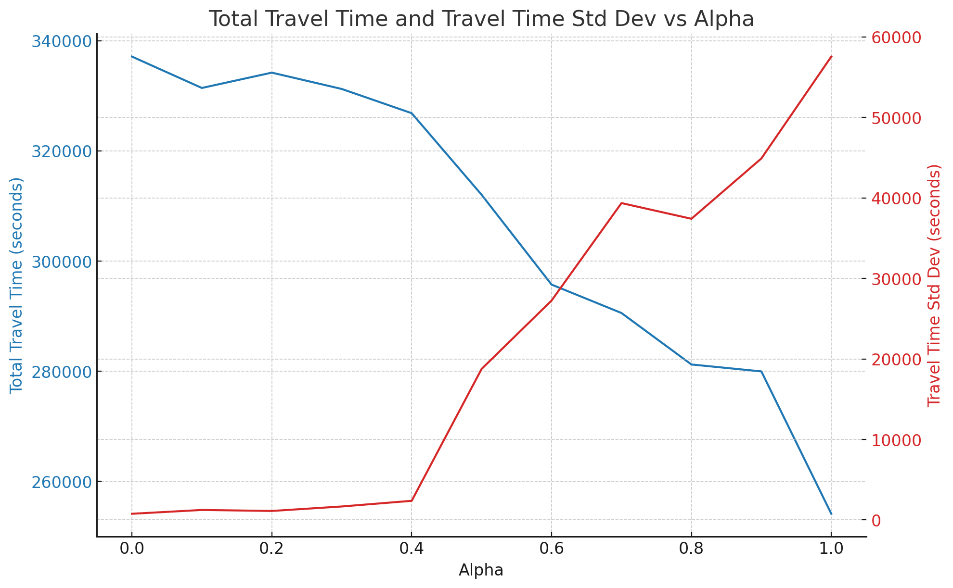
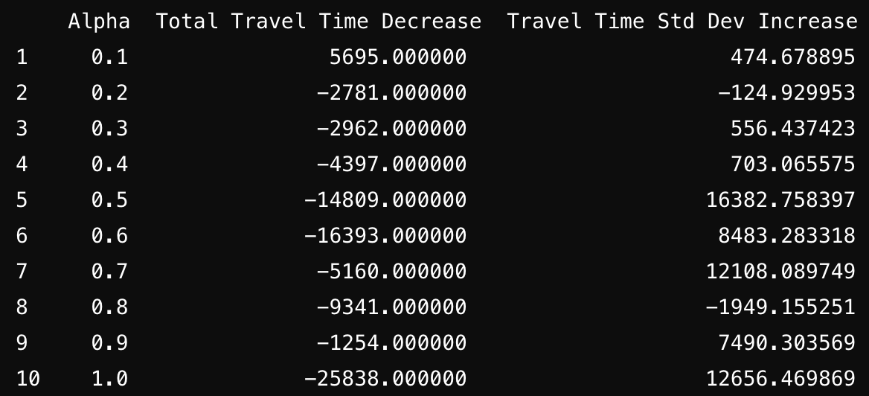
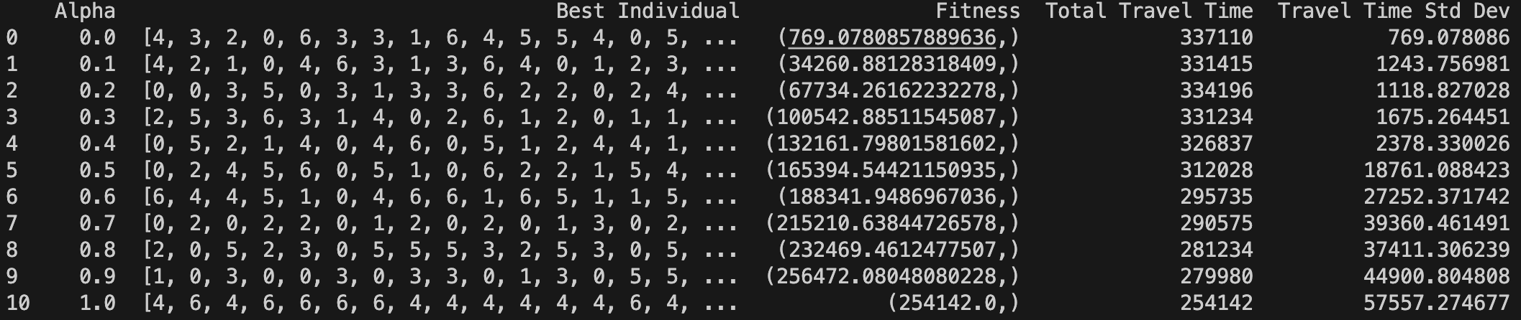
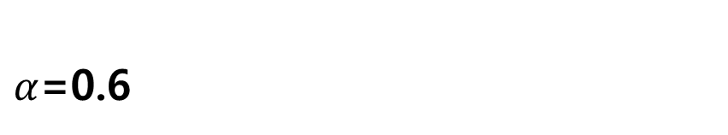
Hyperparameter Tuning
Fitness Function: $α×$ Total Time of Travel + $\left(1−α\right)$ $×$ Deviation between Travel Time Each Day
Candidates of Alpha
$α$=0.6
- Alpha = 0.3~0.4
Total Travel Time Std. Dev/Alpha increased
rapidly right after this point
- Alpha = 0.6
As two graphs intersect at alpha = 0.6

Slide 14
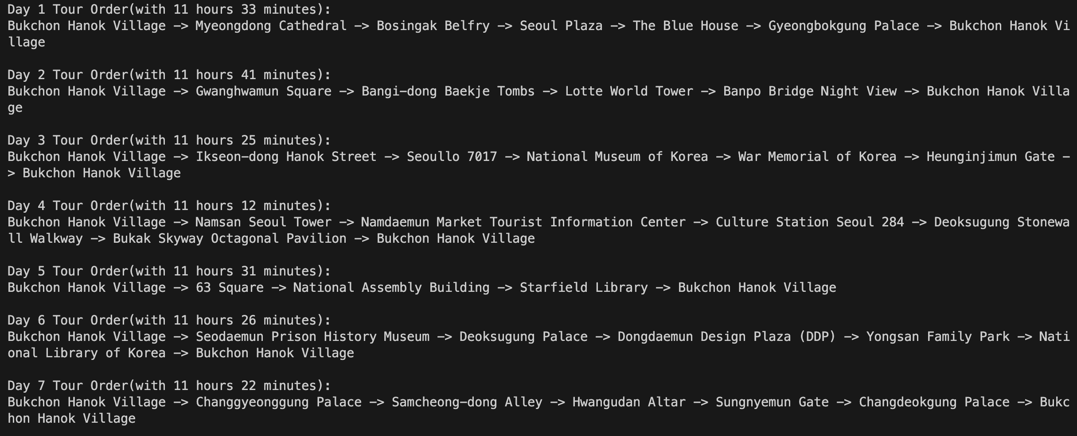
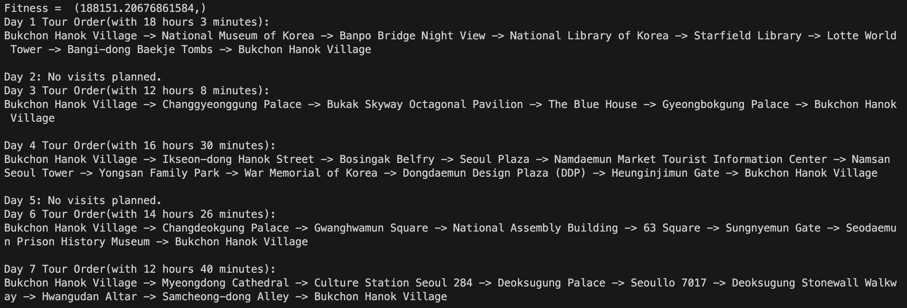
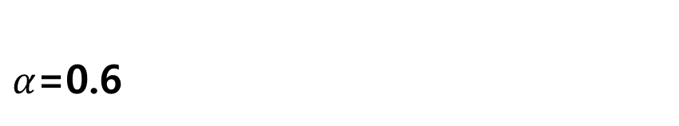
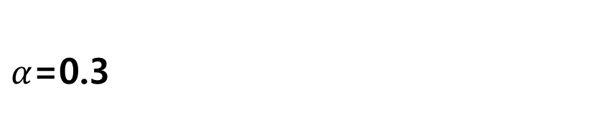
Hyperparameter Tuning
Fitness Function: $α×$ Total Time of Travel + $\left(1−α\right)$ $×$ Deviation between Travel Time Each Day
$α$=0.3
$α$=0.6
Shows feasible solutions in an acceptable
Avg. traveling time and its Std. Dev.
The mean value reduced a lot, but it leads to large variance, making infeasible solution.
We have to find appropriate value of $α$. In this case, we can see that focusing on the Std. Dev slightly more than Avg. by decreasing $α$ leads to a better result.

Slide 15
Conclusion
We found out that clustering using GA gave better tour plan than the source paper.
We also found out that including stay time during solving is important for getting ideal travel plan.
We explained the correlation of Average traveling time and Std. Dev of traveling time with the Alpha value.
We suggested reasonable Alpha value that gives best result considering both Avg, Std. Dev.

Slide 16
Limitation and Future Work
We might also have to consider the opening time window of tourist attractions.
As the travel time and cost varies depending on the time window and on the choice of means of transportation.
We attempted to use Naver Map API to construct data considering real-time and multiple transportations, but it was not included in the current presentation stage.
Because Naver Map API deleted public transportation data and using other methods might cause some legal problems.
By getting admission for the data matter, we might try to implement these real-time and multi transportation terms.

Slide 17
Reference
Rani, S., Kholidah, K. N., & Huda, S. N. (2018). A Development of Travel Itinerary Planning Application using Traveling Salesman Problem and K-Means Clustering Approach. In Proceedings of the 2018 7th International Conference on Software and Computer Applications (ICSCA '18) (pp. 327–331). https://doi.org/10.1145/3185089.3185142
https://data.seoul.go.kr/dataList/OA-21050/S/1/datasetView.do
https://www.google.co.kr/maps/?hl=ko
https://openapi.sk.com/products/detail?svcSeq=57&menuSeq=297
https://www.code.go.kr/stdcode/regCodeL.do

Slide 18
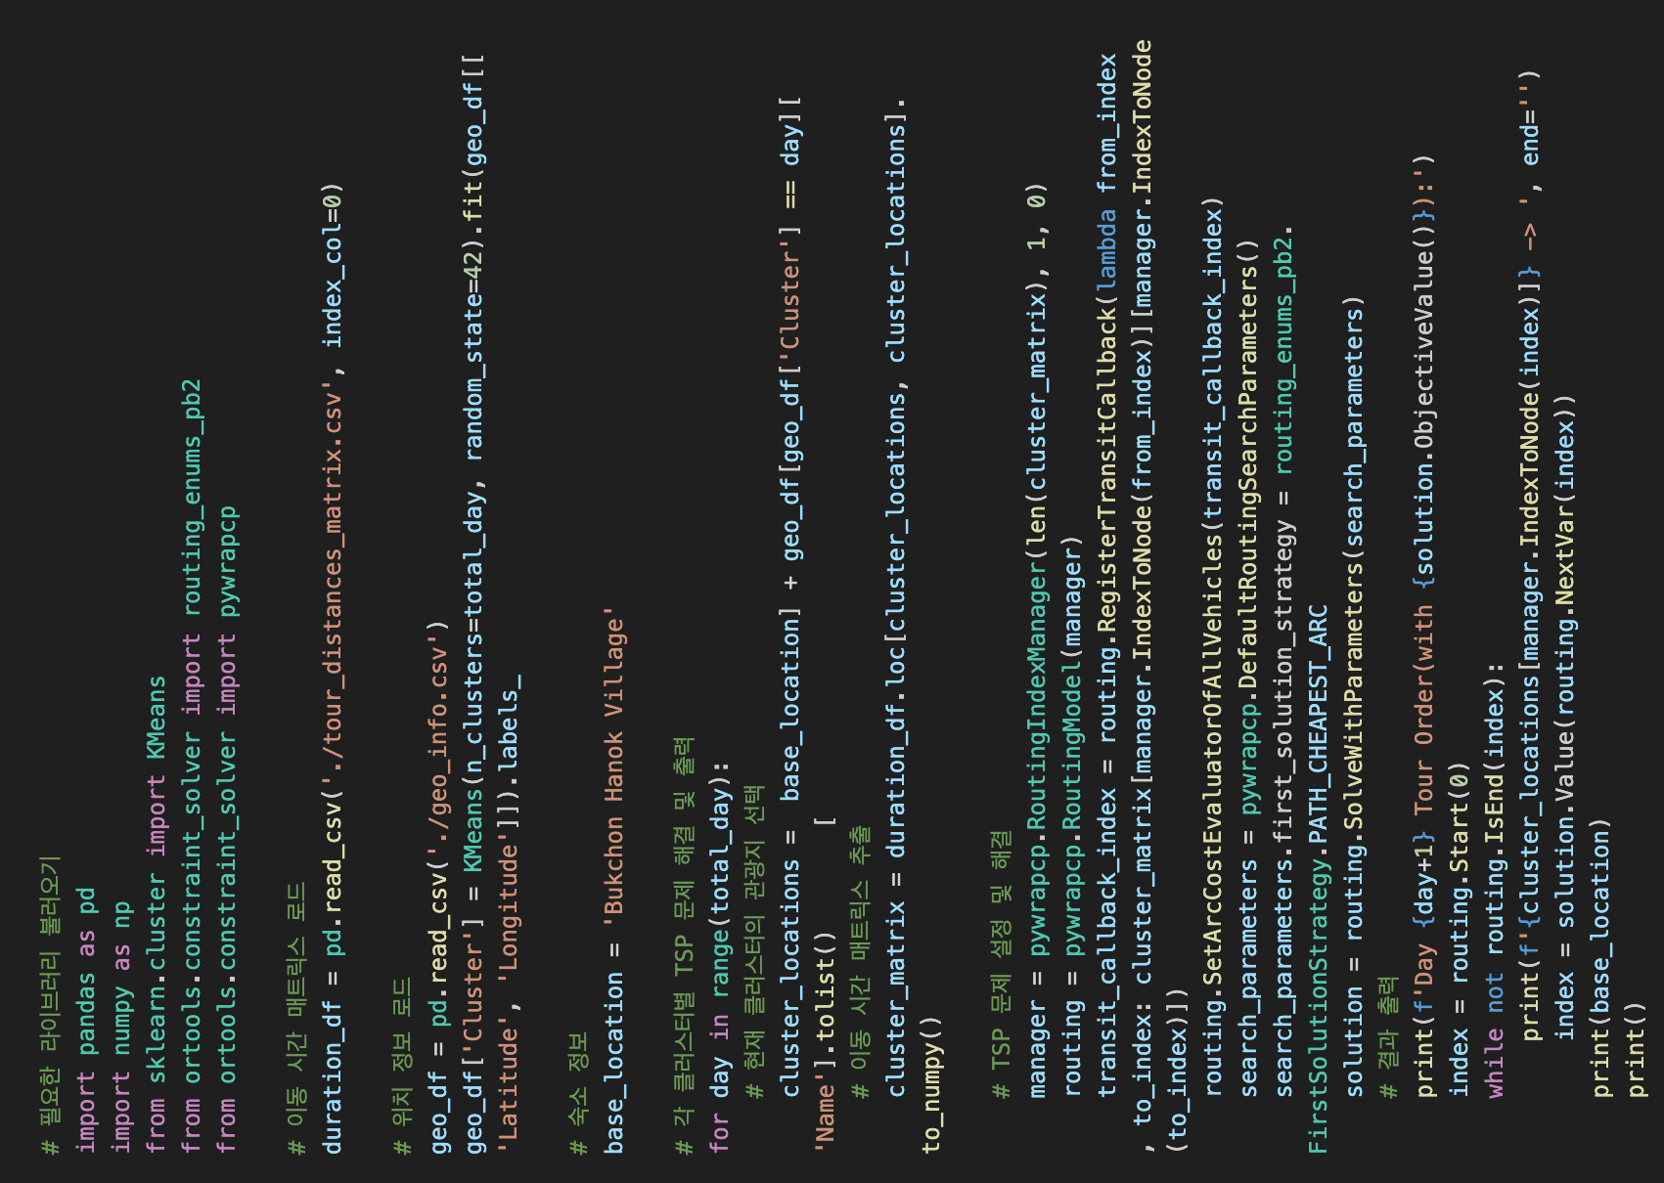
Appendix 1 – Original paper code

Slide 19
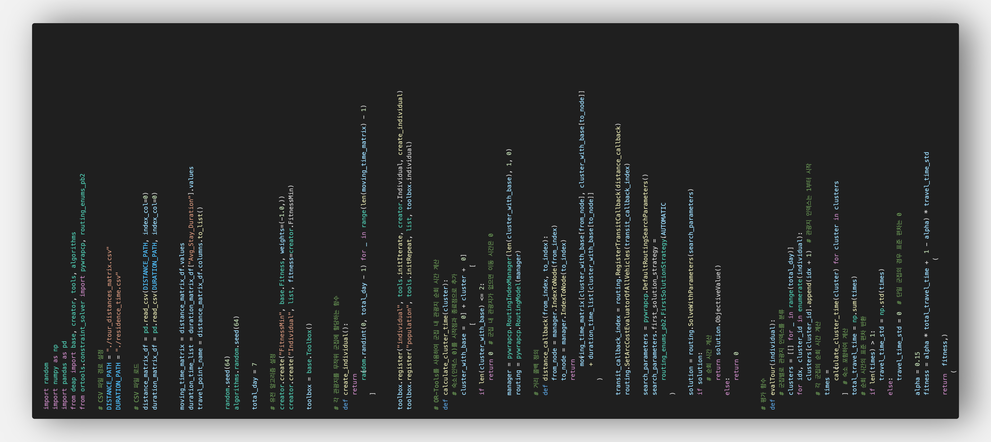
Appendix 2 – Proposed code (GA)

Slide 20
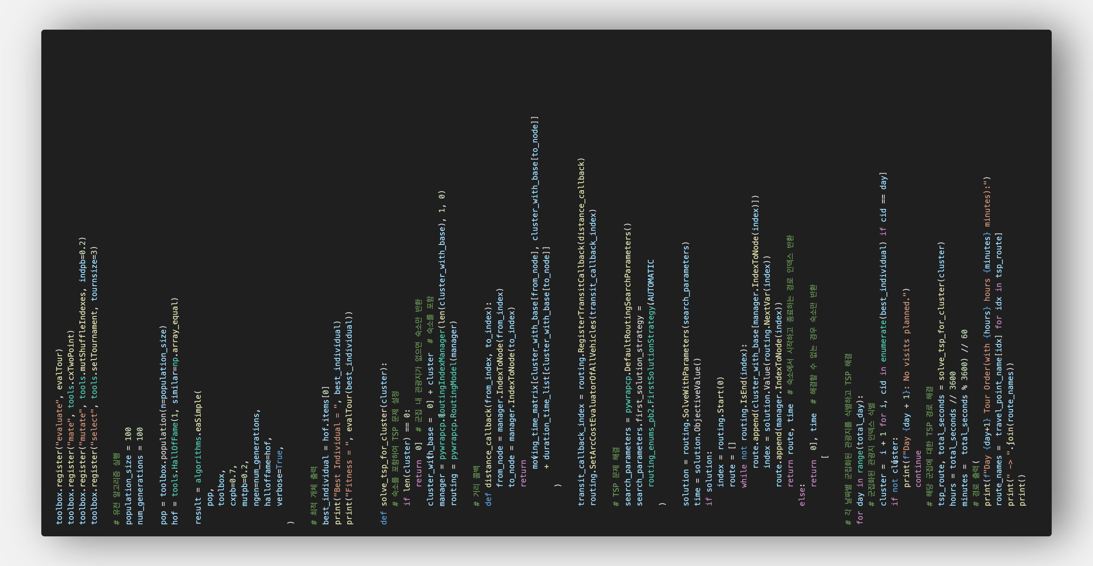
Appendix 2 – Proposed code (GA)

Slide 21
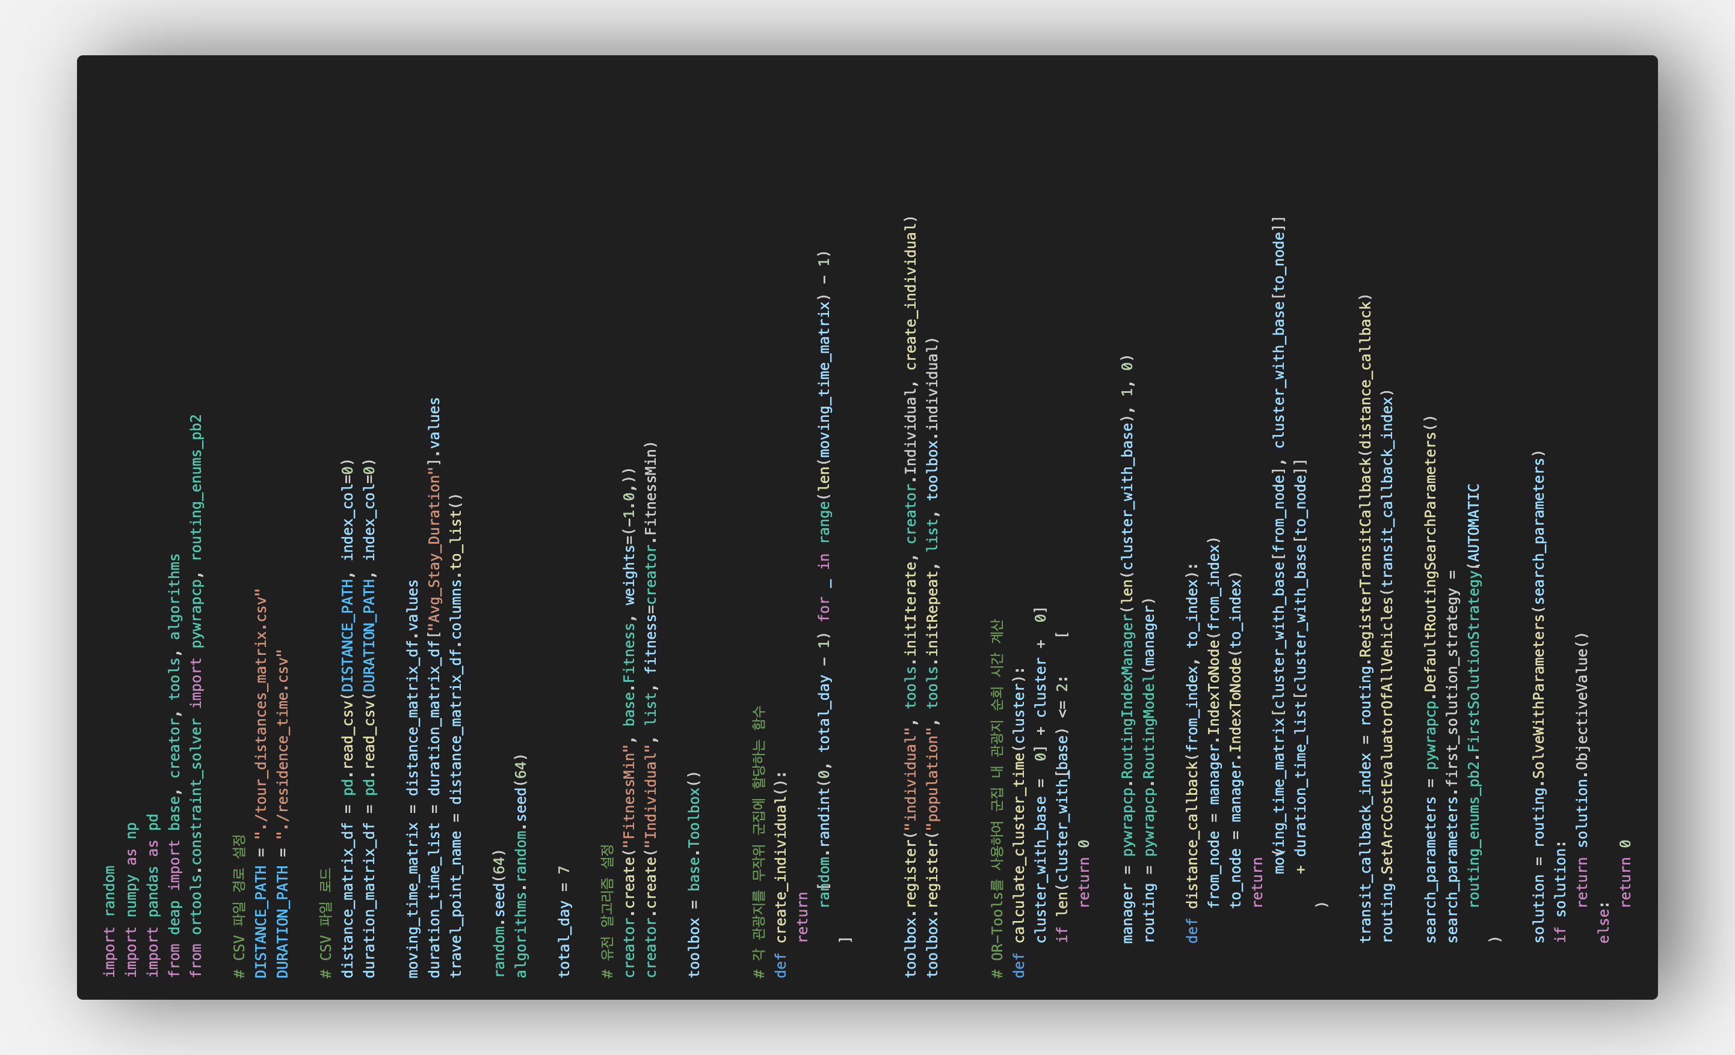
Appendix 3 – Proposed code (Alpha fitting)

Slide 22
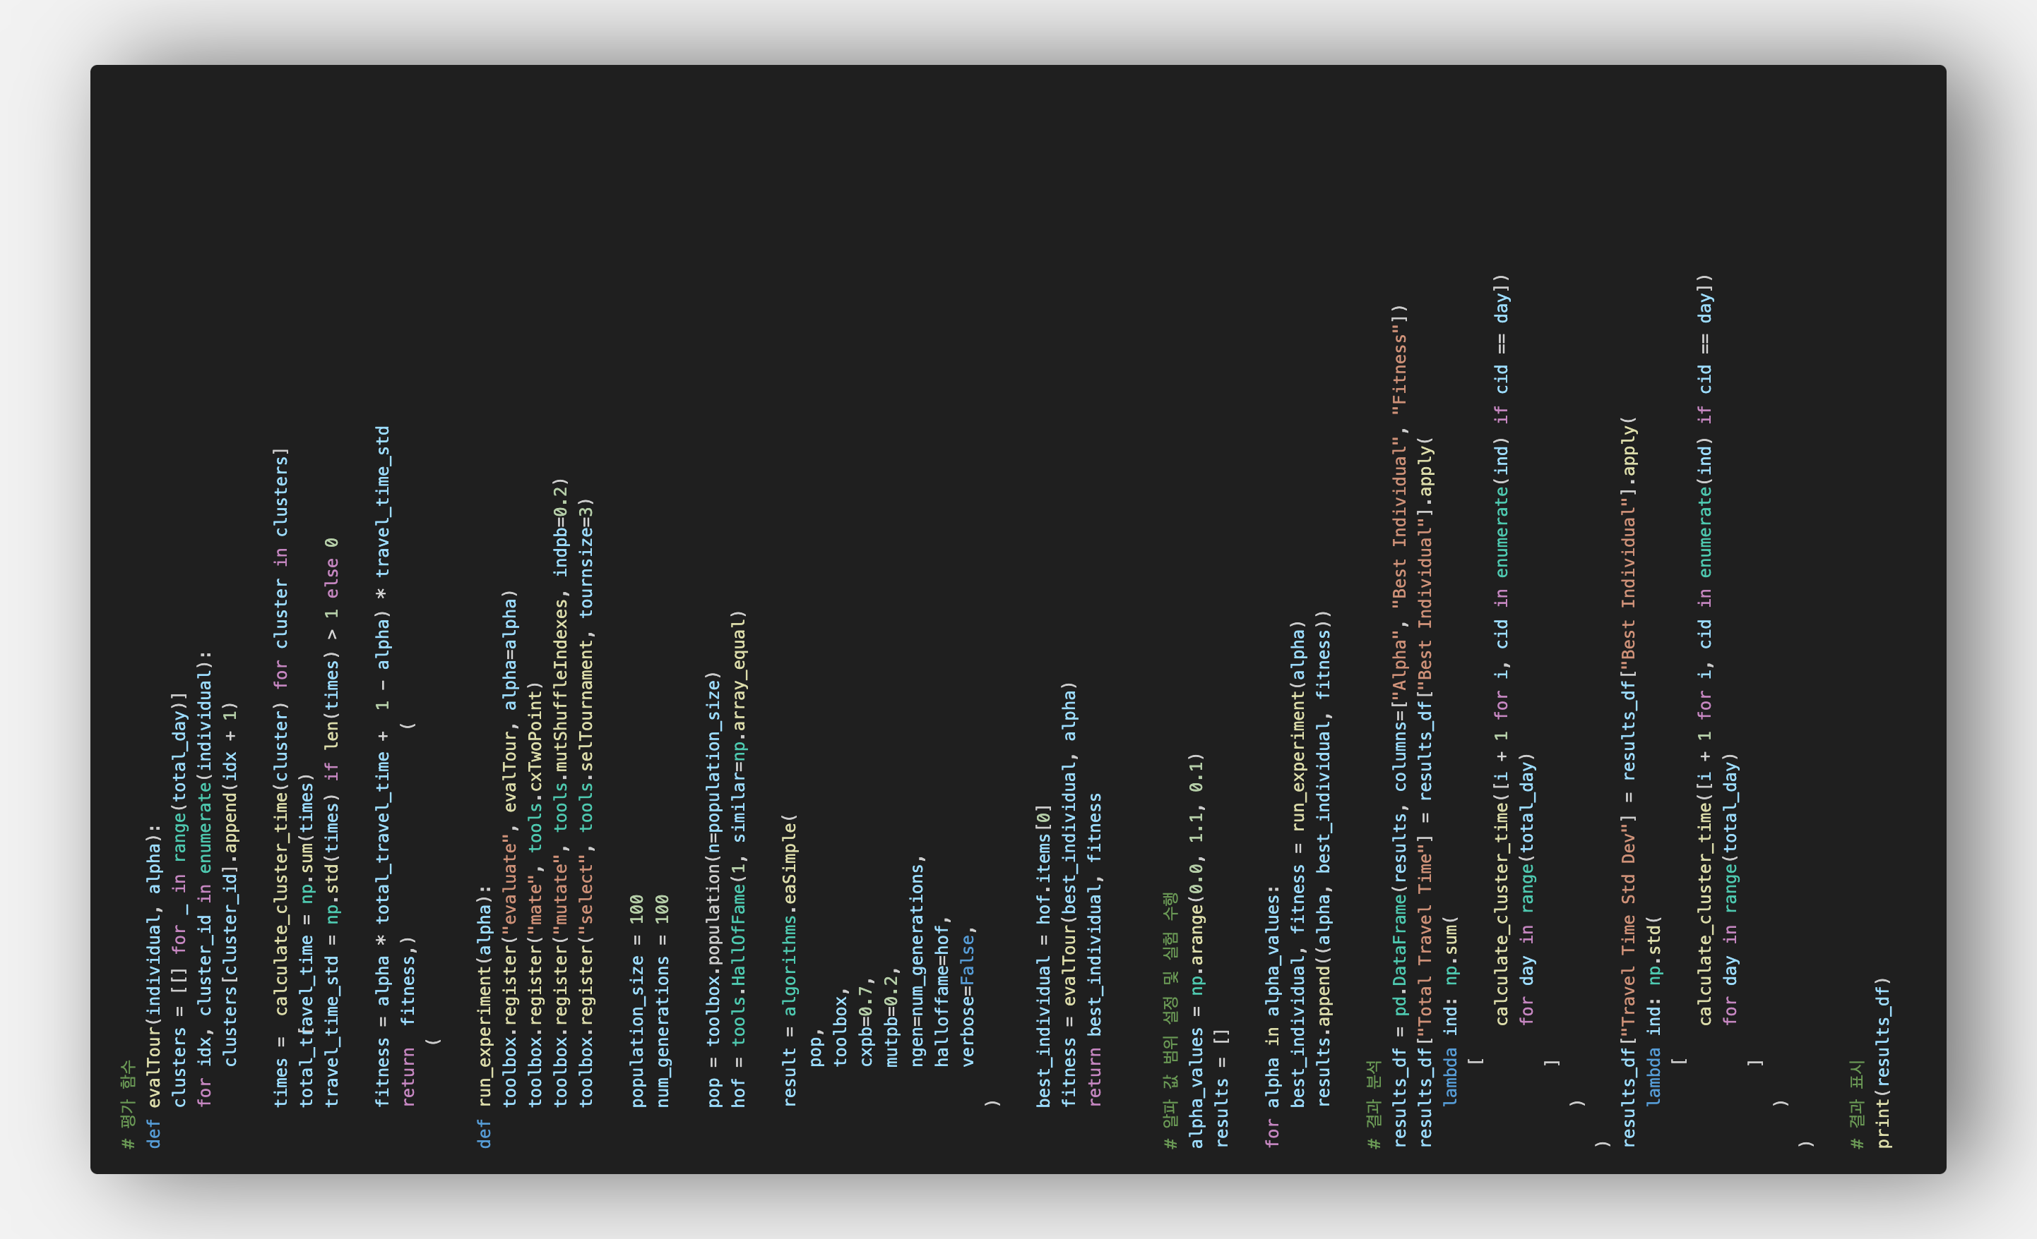
Appendix 3 – Proposed code (Alpha fitting)

